Slide 1
Digital Security Threat in Hospital Systems
Dhruv Amin, Rashmi Hazarika, Jakub Kowal

Slide 2
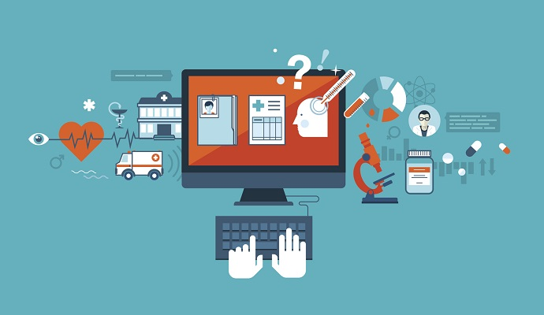
Introduction
As the digital world continues to grow, so do the volume, variety, and velocity of cyber threats and attacks. The world is awash in data, and there is always someone trying to turn it into their own virtual currency. Today malware and ransomware are hitting everything from our personal cell phones to mission-critical infrastructure and supply chains.
We have been hired by a large hospital system to do an analysis of the digital security threat that it may be facing.
Notes:
Our team was tasked by a large hospital system with doing an analysis of digital security threats that the system may be facing. There are many perks that come with the advancement of technology such as making storing data a lot easier but there is also a larger risk of this data being stolen or misused. More healthcare institutions are relying on technology to store data and patient information. It's important to learn more about security threats such as malware and ransomware that can compromise the safety of this data and figure out how these hospital systems can prepare and prevent their data from being stolen.

Slide 3
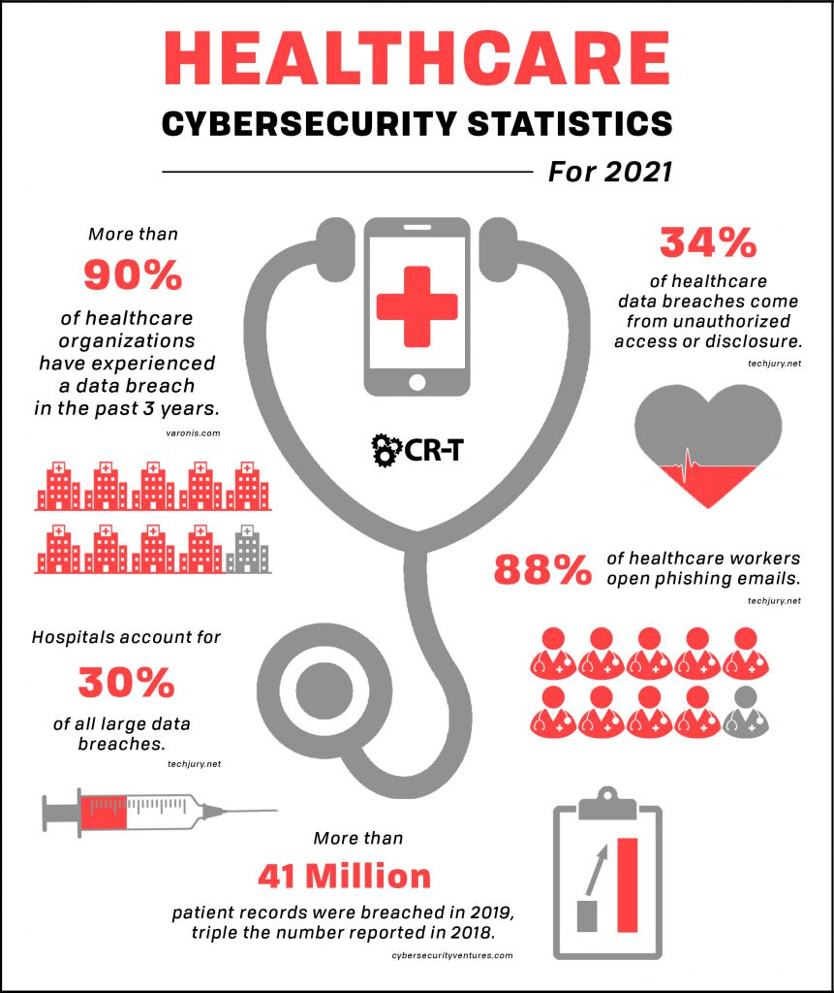
Background
Increased interconnectivity raises digital security concerns
Poses major risks to individuals, corporations, and civilizations
Chronic cybercrime and hacking techniques that are always changing
Data breaches, malware assaults, phishing scams, and ransomware exploits
Can harm personal and organizational privacy, economics, and reputation.
Understanding these dangers is critical for digital security.
Notes:
Because of increased interconnectivity, digital security concerns pose major risks to individuals, corporations, and civilizations.
The danger landscape includes chronic cybercrime and hacking techniques that are always changing.
Data breaches, malware assaults, phishing scams, and ransomware exploits are all threats with serious consequences.
These dangers can have disastrous consequences, harming personal and organizational privacy, economics, and reputation.
Understanding these dangers is critical for successfully traversing the treacherous terrain of digital security.

Slide 4
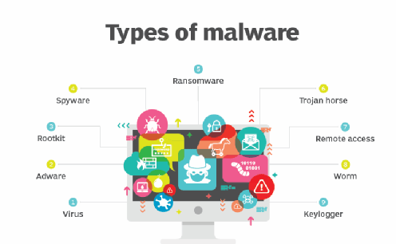
Malware
Malicious software intentionally created to harm a computer, network, or server.
Trojan Horse
Viruses
Spyware
Notes:
Malware is commonly associated with an intentionally created program that has the potential of causing harm to a network system in case it infects computers, stealing data or controlling other applications on the device. These include computer viruses, worms, Trojans, spyware, and adware. Malware also steals data, messes with systems, and overall a slow running machine.
Trojans: A Trojan Horse is a sort of malware that masquerades as legitimate software in order to deceive users into installing it. Once triggered, it can conduct a variety of nefarious acts, such as stealing sensitive data, granting illegal access to a system, or allowing attackers to operate the machine remotely.
Viruses: Viruses are harmful programs that attach themselves to normal files or applications in order to proliferate and spread. They can corrupt, change, or delete data once launched, and in some situations, replicate over a network or system, inflicting significant damage.
Spyware: Spyware is software that is placed on a device without the user's permission in order to collect information about the user's online activity, browsing patterns, or personal information. It frequently acts invisibly, sending acquired data to third parties without the user's knowledge.

Slide 5
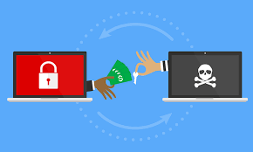
Ransomware
Designed to deny a user or organization access to files on their system
WannaCry
Petya/NotPetya
Notes:
Another kind of malware – ransomware that makes it impossible to use a PC, including the information stored on it, unless you will pay. In this case, it denies people’s right to access information through encryption of files and locking users’ accounts. Perpetrators most of the time instruct on paying for an encryption key and gaining back access to the system.
WannaCry: WannaCry was a 2017 global ransomware attack that exploited a Windows vulnerability, encrypting data on infected computers and demanding Bitcoin ransom payments for decryption, affecting over 200,000 systems in 150 countries and causing widespread disruption in industries such as healthcare and telecommunications.
Petya: Petya was a ransomware strain that first appeared in 2016 and has since resurfaced in various variants, encrypting the master boot record (MBR) of infected computers, rendering them inoperable, and demanding Bitcoin ransom payments for decryption, targeting both individual users and large organizations globally, causing significant disruptions to various sectors and industries.

Slide 6
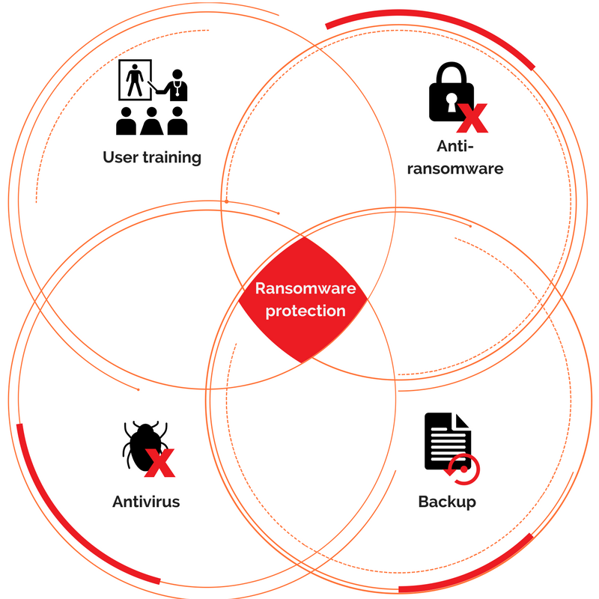
Common Protection Strategies
Use Reliable Security Software
Regular Updates
Backup Data
Educate Users
Network Segmentation
Incident Response Plan

Slide 7
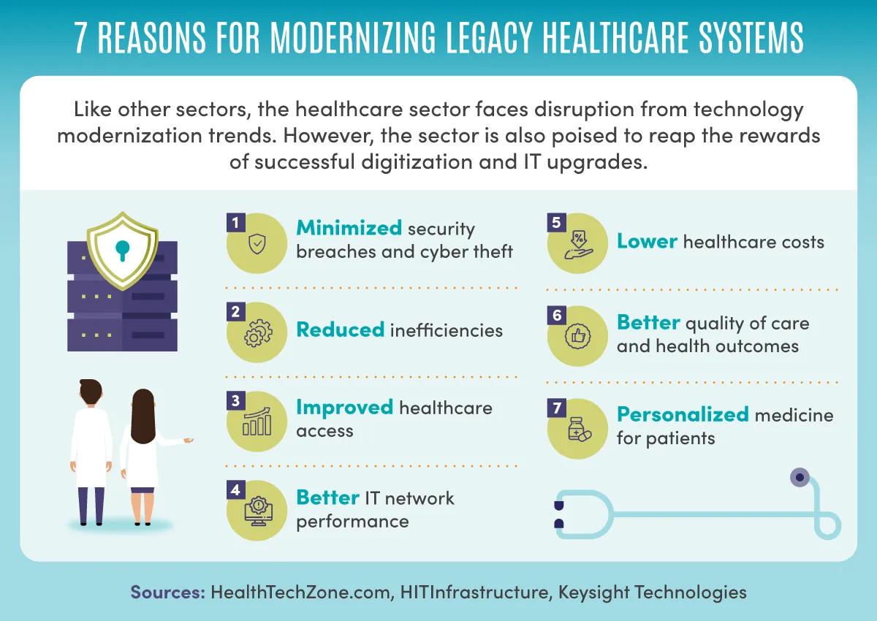
Hospital Information Systems
Manages administrative, financial, and clinical needs
Electronic Health Records (EHRs)
Health tracking devices
Medical equipment
Software used for healthcare delivery and management
Patients
Notes:
Hospital Systems refers to the component of health informatics that places focus largely on the administrative, financial, and clinical needs of hospitals. It is designed to manage any data related to healthcare. Hospitals systems must protect against cyber threats but that’s because they’re protecting a lot of data that could potentially risk the safety of people. Some technologies that hospitals need to protect are Electronic health records or ERD, Health tracking devices, medical equipment, Software used for healthcare delivery and management and Patients. ERD is one of the most valuable as it stores patient data and any info regarding a patient. It’s crucial to protect these technologies and data to ensure medical information doesn’t get leaked and also so patient privacy isnt violated. Modernizing the healthcare system allows for more security over information and easier access to treatments and information as well as better patient care but as there are many technological devices being used so it’s important to take the necessary measures and preventative tactics to ensure data security.

Slide 8
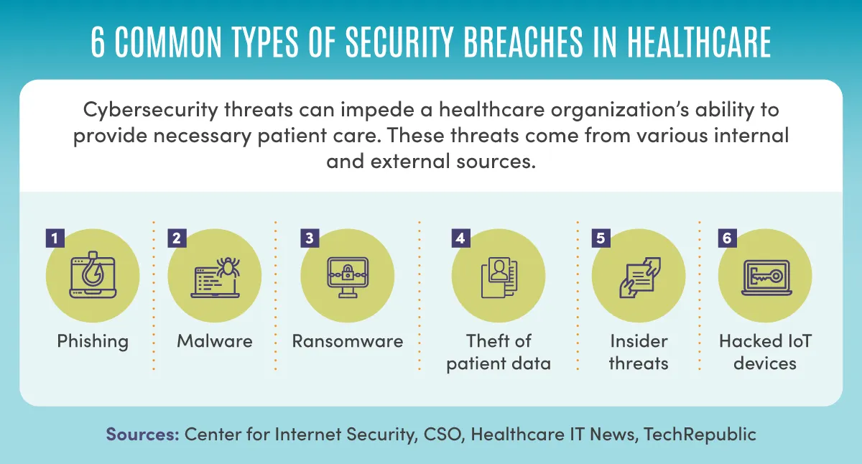
Hospital Security Threats
External with local or remote actors
Internal though deliberate or inadvertent acts
Motives: Financial gains, terrorism
The cybersecurity firm Emsisoft reports that the U.S. had more than 560 cyber attacks against healthcare facilities in 2020
Notes:
Malware and ransomwares are common risks that hospitals need to look out for within their system. It’s important to recognize the risks in order to better protect the systems and better inform employees. External threats can come from both local or remote sources. Local actors tend to exploit vulnerabilities and remote actors will target digital infrastructure. Having good firewalls and detection systems is helpful to prevent external threats. Internal threats are usually more dangerous since deliberate acts such as unauthorized access or accidental acts like unintentional data leaks are often due to someone already working within the system. It's important to train employees accordingly to ensure mistakes don’t happen. People that hack into these systems usually do so for financial gain or terrorism, as certain medical information can cost a lot on the dark web (for example celebrities). The cybersecurity firm Emsisoft reports that the U.S. had more than 560 cyber attacks against healthcare facilities in 2020. Protecting these facilities is a must since it can cost a lot of money to fix and cause ethical issues regarding privacy. As you can see, here are some of the most common security threats to hospitals so it’s important for hospital systems to be aware of them. Phishing scams are most common as it can happen simply by clicking a link in an email. This is usually because the sender seems to be from a trustworthy account. There are many reasons as to why hospital digital systems are at risk which is why it’s important to discuss the vulnerabilities as well.

Slide 9
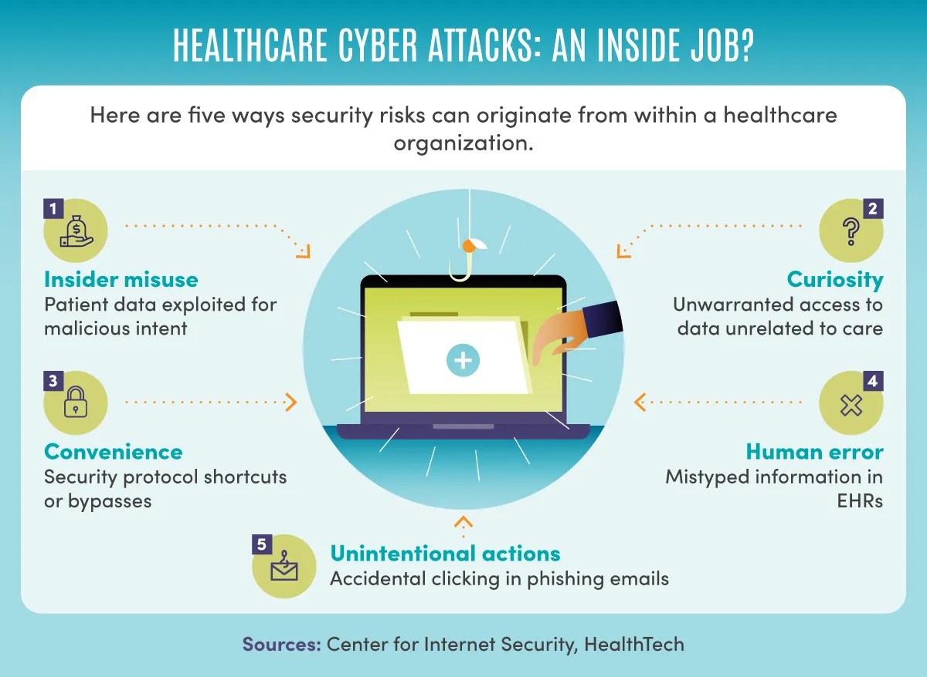
Vulnerabilities
Electronic Patient Record (ERP) Systems focus on functionality over cybersecurity
Nature of the work makes it extremely sensitive to any disruption in its services
Humans are the weakest link in cybersecurity
Notes:
Vulnerabilities can be exploited so being aware of them prevents mistakes and accidents. Many systems within a hospital, especially the system for electronic patient records which focuses on functionality without giving much thought to security. They are designed to streamline healthcare processes, focusing on data accessibility, user-friendliness, and interoperability. This can become a huge vulnerability that malicious actors can exploit. The nature of working in healthcare is also sensitive to disruptions and problems. Many healthcare systems now rely on technology to deliver the necessary care so it can have negative effects when the system gets disrupted. Disruptions are most notably due to human error as users may accidentally delete or modify crucial data causing malfunctions. System administrators can also make mistakes with configurations that can lead to problems within the system. Since these systems are constantly being used and accessed there are many instances that open the system to vulnerabilities. Human error is the reason humans tend to be the weakest link within healthcare systems due to social engineering tactics as people can easily fall victim to it and reveal private information. Taking care of vulnerabilities and establishing preventative strategies is vital to keep the healthcare system running smoothly and provide the most optimal care.

Slide 10
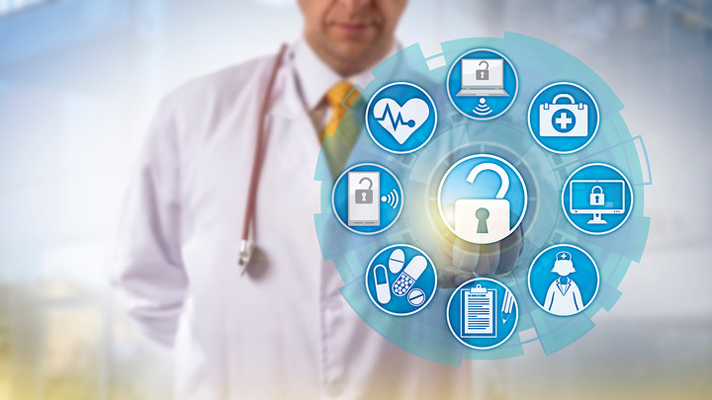
Current Actions taken by Hospitals:
Personal
User training
Practice phishing emails
Authorizations
Multi Factor Authorization (MFA)
Secrecy
Familiarity
Notes:
User training-Users have to take a course when starting the job to ensure they know of the common traps
Practice phishing emails-IT dept sends out phishing emails try and trick people into opening links
Authorizations-Users are only allowed to have access to what they need
Secrecy-If you do not need to know, you probably dont know about it
Familiarity-knowing the IT team is a big boon

Slide 11
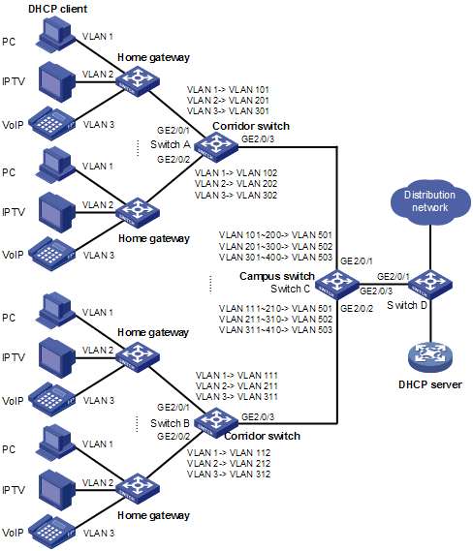
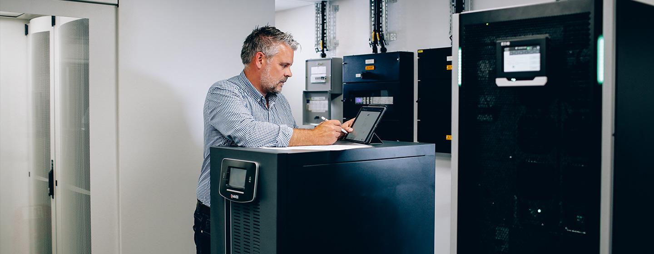
Current Actions taken by Hospitals:
Network
Multiple Networks
Backups
Disaster planning
Collaboration with cyber security experts
Notes:
Multiple networks-VLANs for different devices, makes it harder to hack
Backups-Server team has backups of data in case data is held hostage, is erased
Disaster planning-In case of emergency break glass
Collaboration with cyber security experts-Are constantly on the move to see new technologies that may be of use in protection

Slide 12
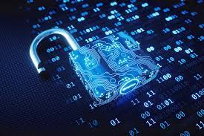
Current Actions taken by Hospitals:
Hardware
Keeping systems up to date
Encryption
Anti-virus software
Notes:
Keeping systems up to date-Basic windows updates go a long way, most users do not update, best practice: push updates overnight
Encryption-bitlocker and filevault can be enabled on most computers
Anti-Virus software-Can be used to detect a number of threats. Hospitals will have av from another provider as they are great way to test out the software for vendors

Slide 13
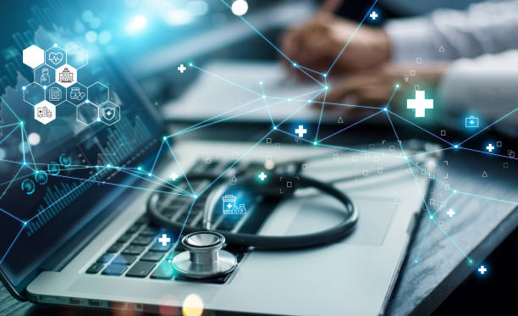

Conclusion
Malware and ransomware are major security threats
Hospital systems store health and patient information
Critical steps include improving security procedures, raising staff awareness, revising contingency actions, and incorporating ongoing assessment in real time
Notes:
Briefly, it seems that the threats to digital security in the hospital system appear as a complicated situation in development, including weaknesses in current provisions and risk of using modern infection of malwares and blackmailing software.
Therefore, urgent action must be taken towards reducing these risks. Critical steps include improving security procedures, raising staff awareness, revising contingency actions, and incorporating ongoing assessment in real time. As a result, it is vital for institutions to apply proactive measures to keep track of evolving security risks that threaten their crucial assets and operations.

Slide 14
References
https://www.ncbi.nlm.nih.gov/pmc/articles/PMC7062337/
https://bmcmedinformdecismak.biomedcentral.com/articles/10.1186/s12911-018-0724-5
https://usa.kaspersky.com/resource-center/threats/ransomware-attacks-and-types
https://online.maryville.edu/blog/healthcare-cybersecurity/
https://www.emsisoft.com/en/blog/37314/the-state-of-ransomware-in-the-us-report-and-statistics-2020/
https://www.talkinghealthtech.com/glossary/hospital-information-systems-his
https://www.digitalguardian.com/blog/20-information-security-tips-hospitals
https://www.ncbi.nlm.nih.gov/pmc/articles/PMC2655907/
https://www.ivanti.com/blog/securing-iomt-devices-best-practices-for-hospitals-to-prevent-cyberattacks
https://www.techtarget.com/searchsecurity/definition/malware
https://www.checkpoint.com/cyber-hub/threat-prevention/ransomware/

